Slide 1
Computational Analysis of Single-cell Omics Data Workshop
Sharon Long, Carissa Chen, Pengyi Yang
Computational Systems Biology Unit, Children’s Medical Research Institute, Sydney Medical School

Slide 2
Schedule
Session 1: 9:50 – 10:00 Introduction to single-cell multiomic data and integrative analysis
Session 2: 10:00 – 11:30 Multi-modal analysis of CITE-seq data with CiteFuse
Session 3: 11:40 – 12:30 Basics of 10x multiome data analysis
Wrap up: 15:30 – 16:00 Conclusion and wrap up
Session 4: 13:30 – 14:20 Introduction to Matilda
Session 5: 14:30 – 15:30 Multi-modal analysis of 10x multiome data with Matilda
Setting up: 9:30 – 9:50 Google cloud and Colab set up
Short break: 11:30 – 11:40
Lunch break: 12:30 – 13:30
Short break: 14:20 – 14:30

Slide 3
Setting up: 9:30 – 9:40
Google cloud and Colab set up

Slide 4
Configuring Google Cloud
Workshop material
https://carissaynchen.github.io/SCMultiome-CNRS-workshop-R/
Machine 1: http://34.38.193.187/
Machine 2: http://34.22.129.0/
After login, please type the following code in the console:
system(paste0("cp -r /home/gittmp/data/ ", getwd()))
setwd(’ ./vignettes’)
Prepare Google account for Colab
Configuring Google Colab
Notes:
Before we begin, you will be able to find all workshop material on our Github page following the first link.
And you will need access to the code and data that we will be using today on Google Cloud. All instructions to getting an account to access the Google Cloud can be found on this link.
https://sydneybiox.github.io/scdneyAdvancedPhenotyping/articles/advanced_phenotyping.html https://docs.google.com/spreadsheets/d/1zHbboRNedmdcfXaSDaQ9BRO2FNdsexwQkp7Vp-2E0eg/edit#gid=0
If you have any issues, please post on chat, and one of our staff will be able to help you.

Slide 5
Session 1: 9:40 – 10:00
Introduction to single-cell multiomic data and integrative analysis

Slide 6
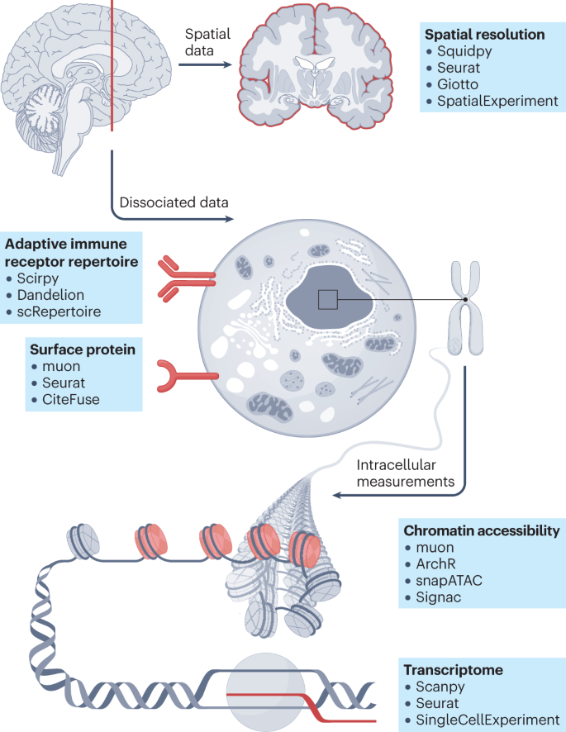
Multi-omics measurement increases the capacity to explore cell various characteristics
(Heumos et al., 2023)
Notes:
We now have a better picture of the cell (take all the layers into account).
https://www.nature.com/articles/s12276-020-00499-2
Single-cell sequencing techniques from individual to multiomics analyses
Yukie Kashima,
Yoshitaka Sakamoto,
Keiya Kaneko,
Masahide Seki,
Yutaka Suzuki &
Ayako Suzuki
Experimental & Molecular Medicine

Slide 7
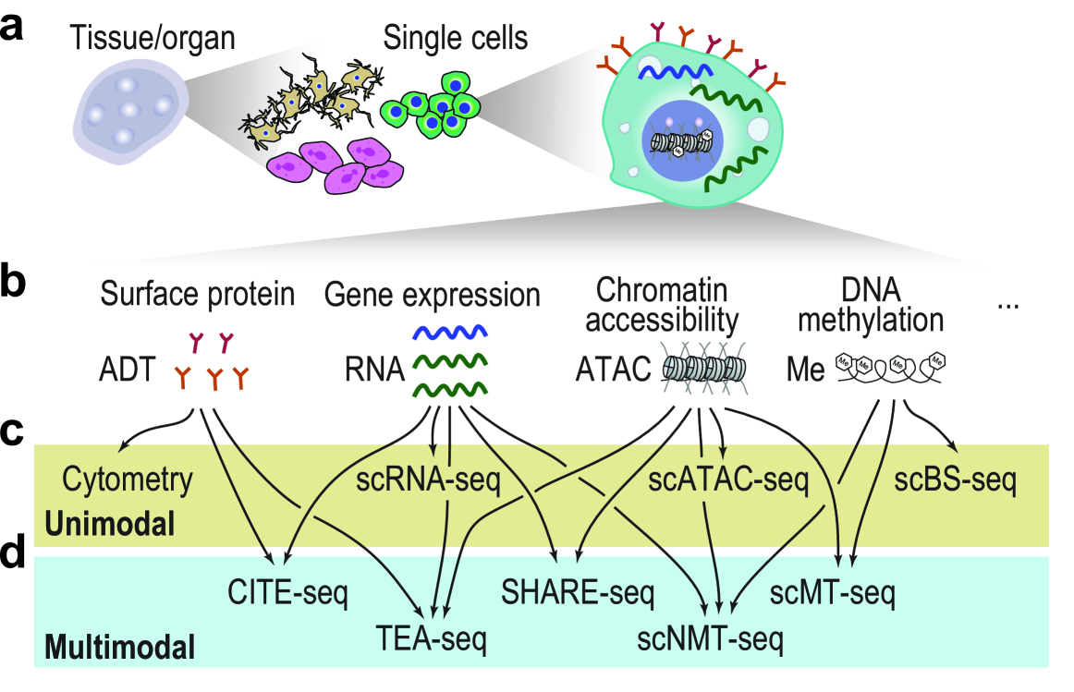
Single-cell multi-omics technologies
10x multiome
(Wagle and Long et al. (2024) Bioinformatics)

Slide 8
Single-cell multi-omics technologies
10x multiome
(Wagle and Long et al. (2024) Bioinformatics)

Slide 9
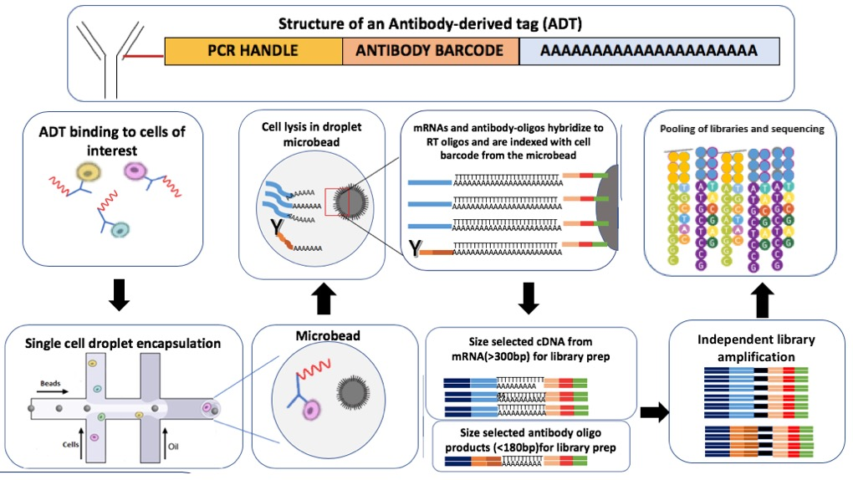
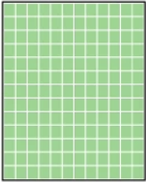
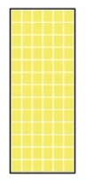
CITE-seq
CITE-seq (Cellular Indexing of Transcriptomes and Epitopes by Sequencing)
Antibody-bound oligos act as synthetic transcripts that are captured during most large-scale oligodT-based scRNA-seq library preparation protocols, e.g., 10x Genomics, Drop-seq, ddSeq.
What is CITE-seq?
Sequencing-based method that simultaneously quantifies cell surface protein and transcriptomic data with a single cell readout,
i.e., scRNA-seq, with Proteins on the side
Advantages of CITE-seq?
Additional resolution of surface markers that can help define different cell states, e.g., in PBMCs where there are many T subtypes (CD4+/CD8+)
Infer post-translational modifications on the protein-level
Together with whole transcriptome and surface proteomic expression, we can identify heterogeneity missed by scRNA-seq alone
Schematic of the wet lab workflow for CITE-seq
(wikipedia)
Genes
Proteins
Cells
Structure of processed count matrix

Slide 10
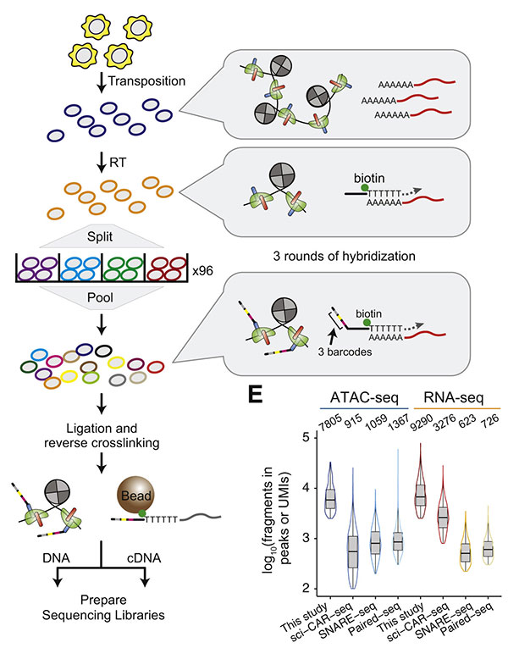
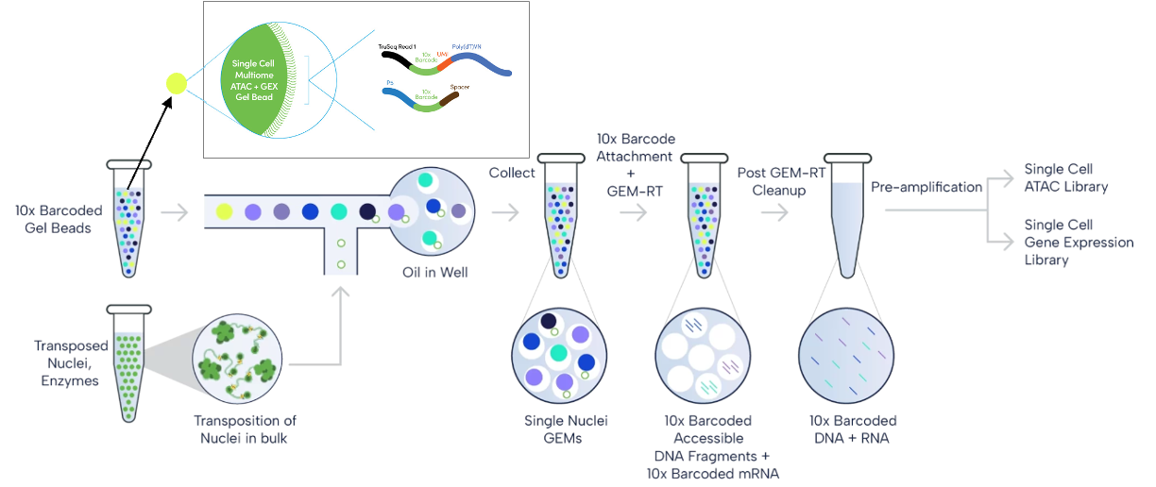
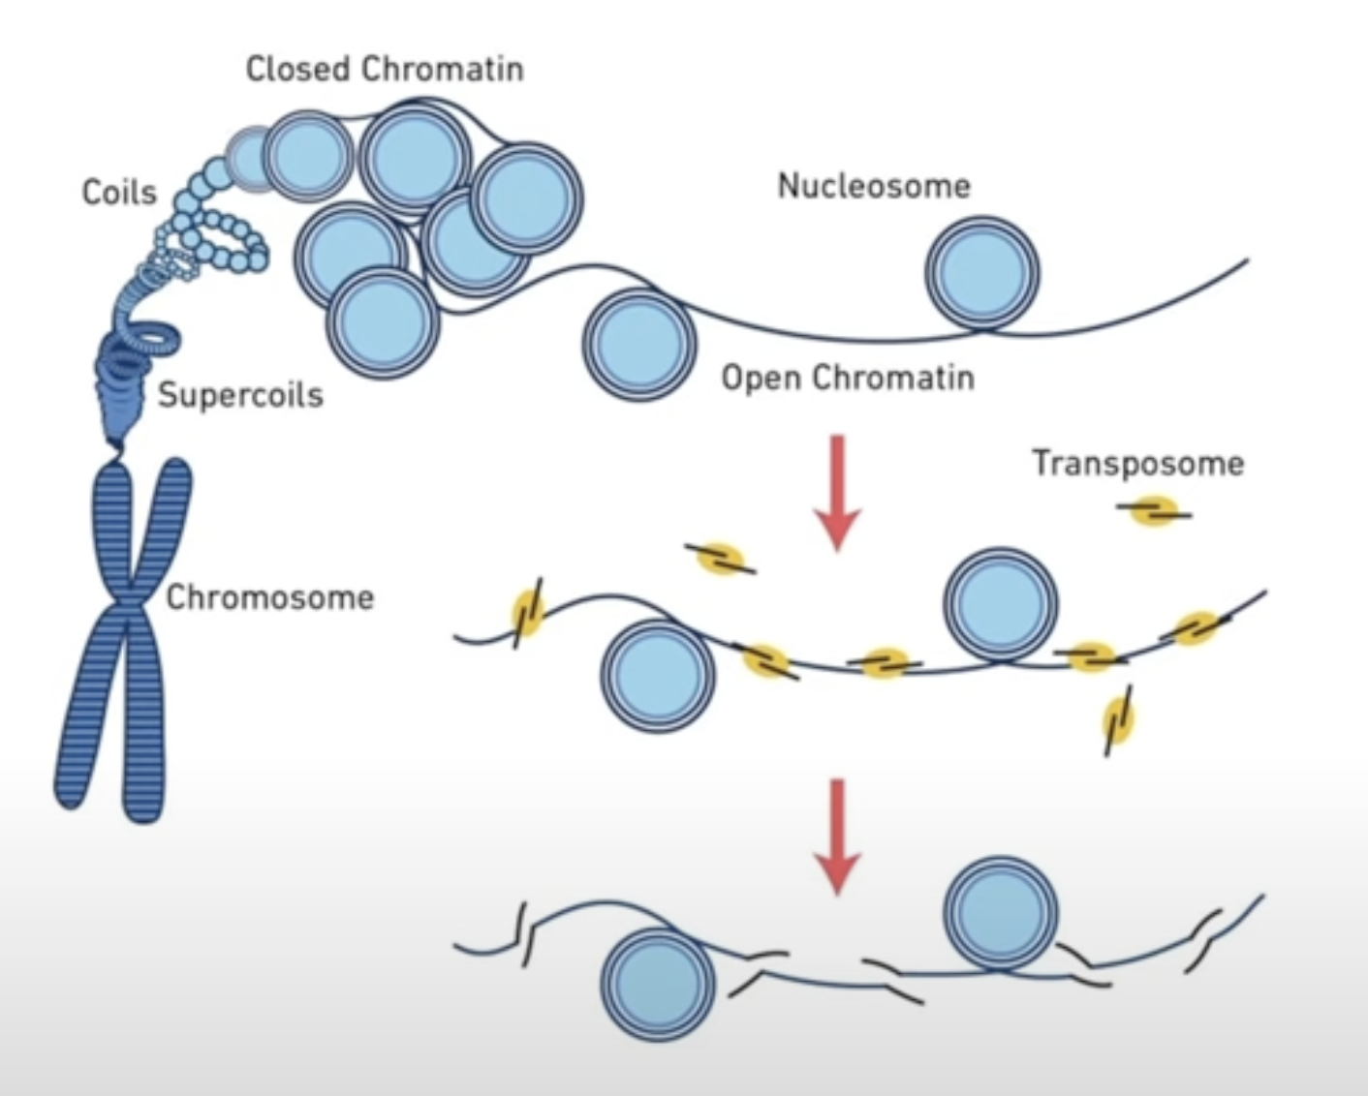
SHARE-seq and 10x multiome
Schematic of the wet lab workflow for SHARE-seq
(Ma et al, (2020), Cell)
Schematic of the wet lab workflow for 10x multiome
(10x Genomics)
SHARE-seq (Simultaneous High-throughput ATAC, and RNA Expression with sequencing)
and 10x multiome (Chromium Single Cell Multiome ATAC + Gene Expression):
Sequencing-based methods that can simultaneously measure chromatin accessibility and gene expression in the same single cell.
More comprehensive cell population identification with gene expression + chromatin accessibility profile.
Maps regulatory networks in single cells: What regulatory elements are active? Where are transcription factors binding? What are the unique gene networks in each cell type?
Genes
Peaks
Cells
Structure of processed count matrix

Slide 11
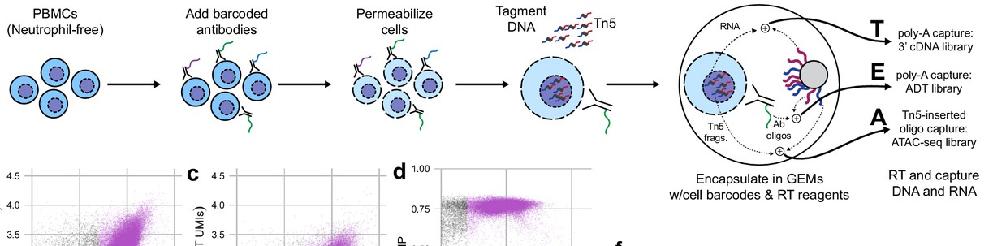
TEA-seq
TEA-seq (single-cell analysis of mRNA transcripts, surface protein epitopes and chromatin accessibility)
What is TEA-seq?
Trimodal-assay that combines the mRNA transcripts, surface protein epitopes and chromatin accessibility
Motivation and advantages
Capture different cell states revealed by distinct modalities
Confirming whether transcriptional, chromatin accessibility changes translate to changes at the protein level
Understanding the dynamic cellular response under perturbations or conditions
Schematic of the wet lab workflow for TEA-seq
(Swanson et al, (2021), Elife)
Genes
Proteins
Peaks
Cells
Structure of processed count matrix

Slide 12
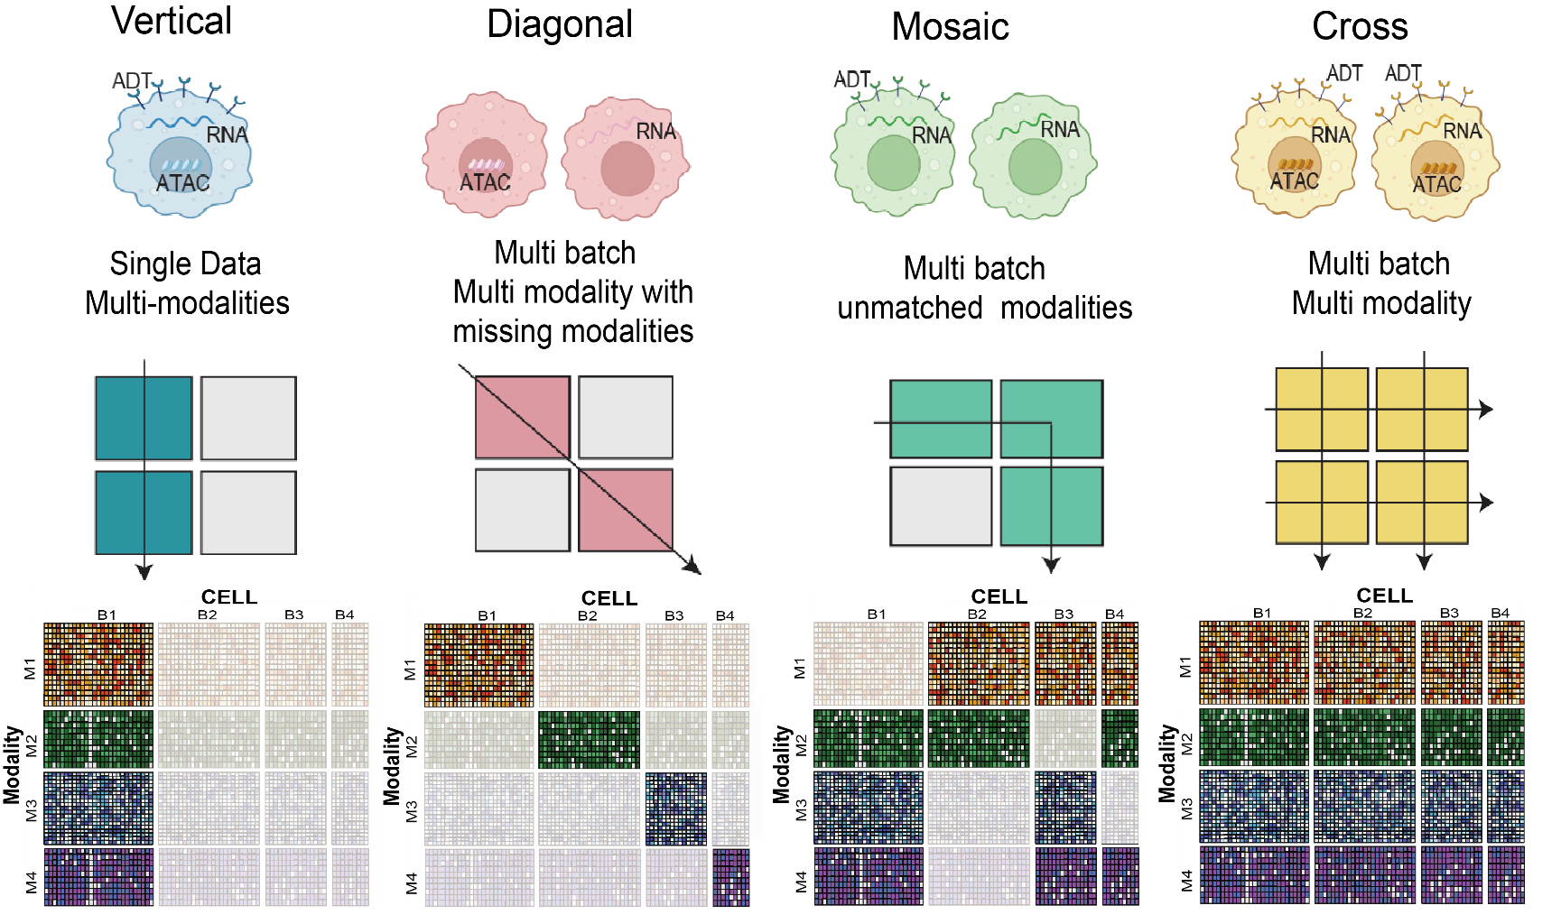
Single-cell Multiomic Data Type
Single batch
Multi-modality
(Liu et al. (under review) Nature Methods)

Slide 13
Single-cell Multiomic Data Type
Single batch
Multi-modality
Multi-batch
Multi-modality
Each batch has 1 modality
(Liu et al. (under review) Nature Methods)

Slide 14
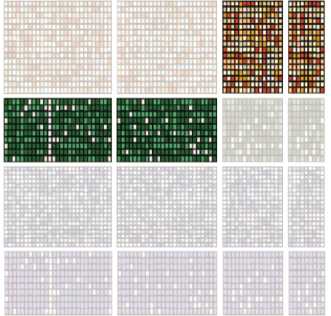
Single-cell Multiomic Data Type
Single batch
Multi-modality
Multi-batch
Multi-modality
Each batch has 1 modality
(Liu et al. (under review) Nature Methods)

Slide 15
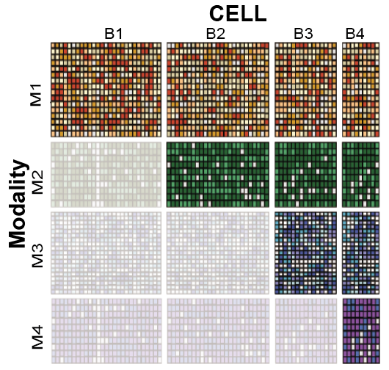
Single-cell Multiomic Data Type
Single batch
Multi-modality
Multi-batch
Multi-modality
Each batch has 1 modality
Multi-batch
Multi-modality
Missing modalities
(Liu et al. (under review) Nature Methods)

Slide 16
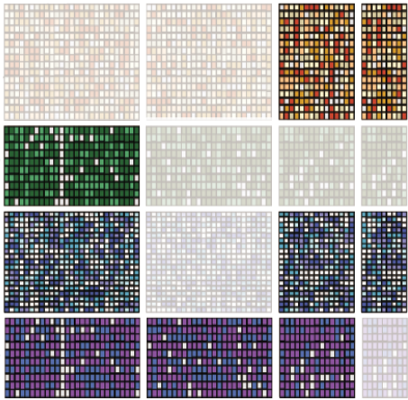
Single-cell Multiomic Data Type
Single batch
Multi-modality
Multi-batch
Multi-modality
Each batch has 1 modality
Multi-batch
Multi-modality
Missing modalities
(Liu et al. (under review) Nature Methods)

Slide 17
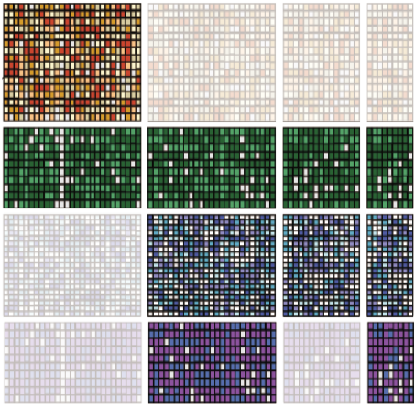
Single-cell Multiomic Data Type
Single batch
Multi-modality
Multi-batch
Multi-modality
Each batch has 1 modality
Multi-batch
Multi-modality
Missing modalities
(Liu et al. (under review) Nature Methods)

Slide 18
Single-cell Multiomic Data Type
Single batch
Multi-modality
Multi-batch
Multi-modality
Each batch has 1 modality
Multi-batch
Multi-modality
Missing modalities
Multi-batch
Multi-modality
No missing modalities
(Liu et al. (under review) Nature Methods)

Slide 19
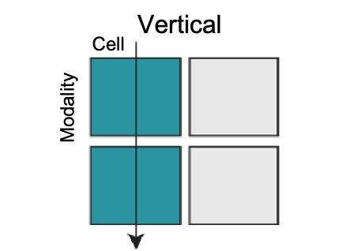
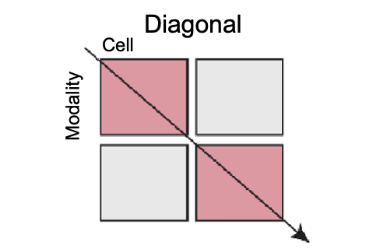
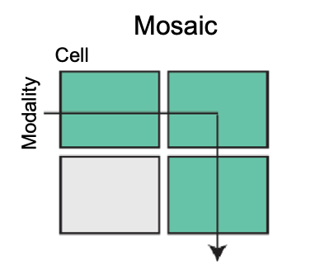
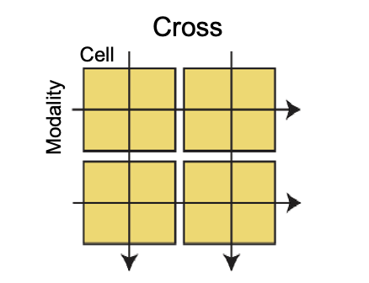
Single-cell Multiomic Data Integration
Single batch
Multi-modality
Multi-batch
Multi-modality
Each batch has 1 modality
Multi-batch
Multi-modality
Missing modalities
Multi-batch
Multi-modality
No missing modalities
(Liu et al. (under review) Nature Methods)

Slide 20
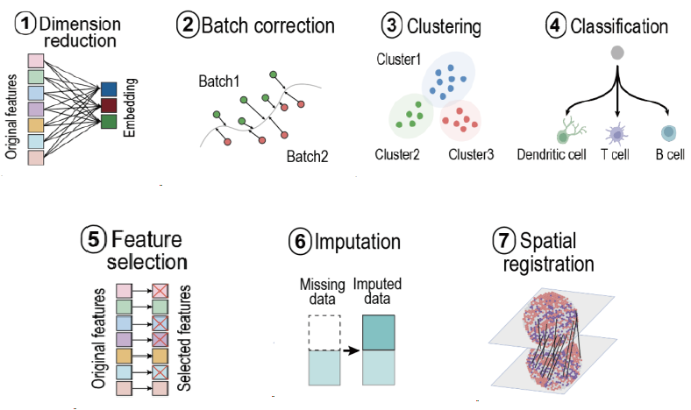
Single-cell Multiomic Data – Integrative Analytical Tasks
Common downstream integrative analytical tasks
(Liu et al. (under review) Nature Methods)

Slide 21
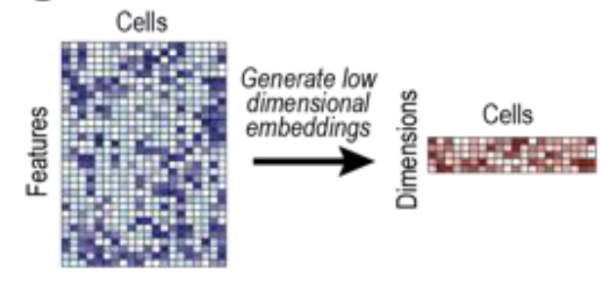
Single-cell Multiomic Data – Integrative Analytical Tasks
Common downstream integrative analytical tasks
(Liu et al. (under review) Nature Methods)

Slide 22
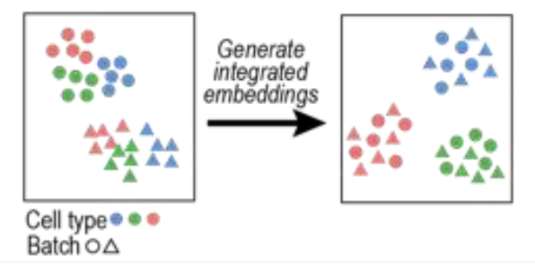
Single-cell Multiomic Data – Integrative Analytical Tasks
Common downstream integrative analytical tasks
(Liu et al. (under review) Nature Methods)

Slide 23
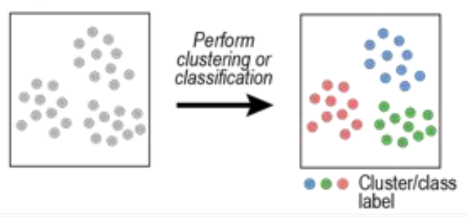
Single-cell Multiomic Data – Integrative Analytical Tasks
Common downstream integrative analytical tasks
(Liu et al. (under review) Nature Methods)

Slide 24
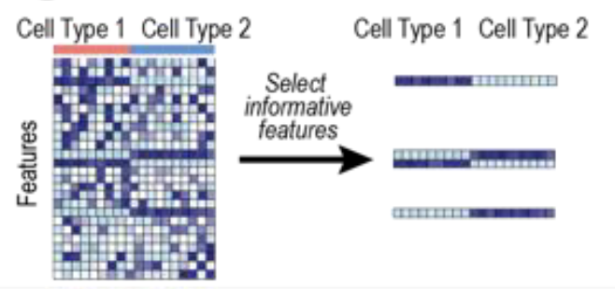
Single-cell Multiomic Data – Integrative Analytical Tasks
Common downstream integrative analytical tasks
(Liu et al. (under review) Nature Methods)

Slide 25
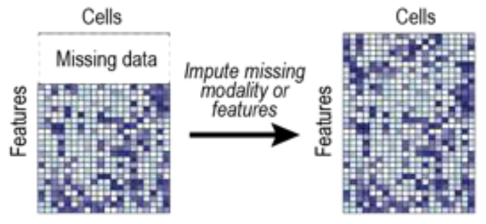
Single-cell Multiomic Data – Integrative Analytical Tasks
Common downstream integrative analytical tasks
(Liu et al. (under review) Nature Methods)

Slide 26
Session 2: 10:00 – 11:30
Multi-modal analysis of CITE-seq data with CiteFuse

Slide 27
☕️ Short break: 11:30 – 11:40

Slide 28
Session 3: 11:40 – 12:30
Basics of 10x multiome data analysis

Slide 29
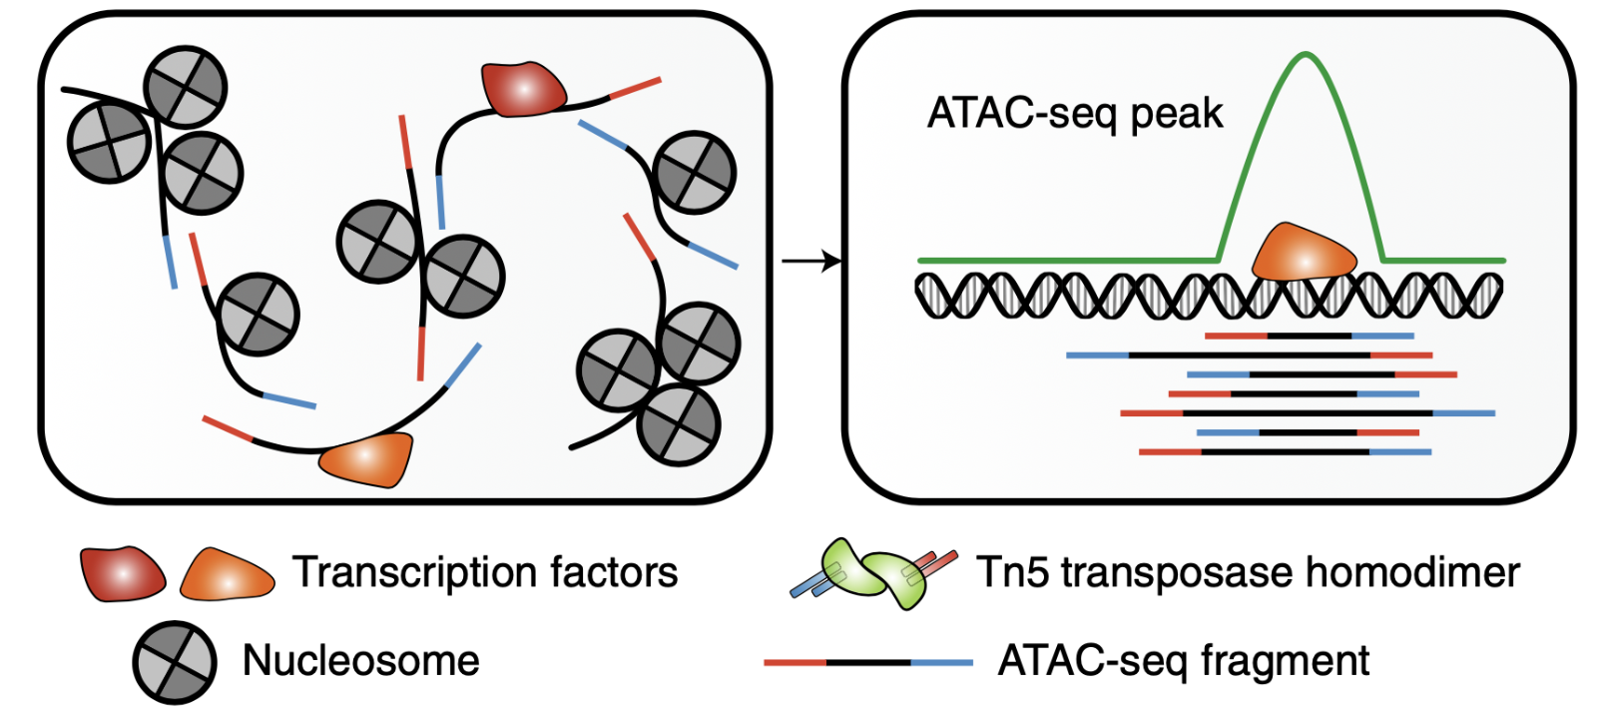
ATAC-Peaks
Genes
Peaks
Cells
Structure of processed count matrix

Slide 30
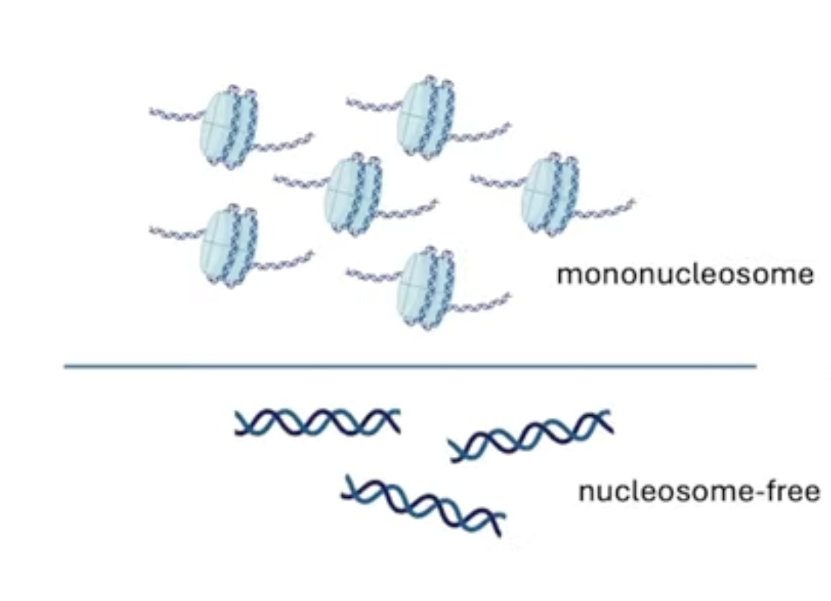
QC metrics of ATAC-seq – Nucleosome Signal
Idea: To retain fragments free of nucleosome
Nucleosome Signal =
147 bp ~ 294 bp
<147bp

Slide 31
QC metrics of ATAC-seq – Nucleosome Signal
Idea: Open chromatin = Gene transcription
= Nucleosome free regions enriched at TSS
Fragments centered at TSS
TSS enrichment score =
Fragments in TSS flanking regions

Slide 32
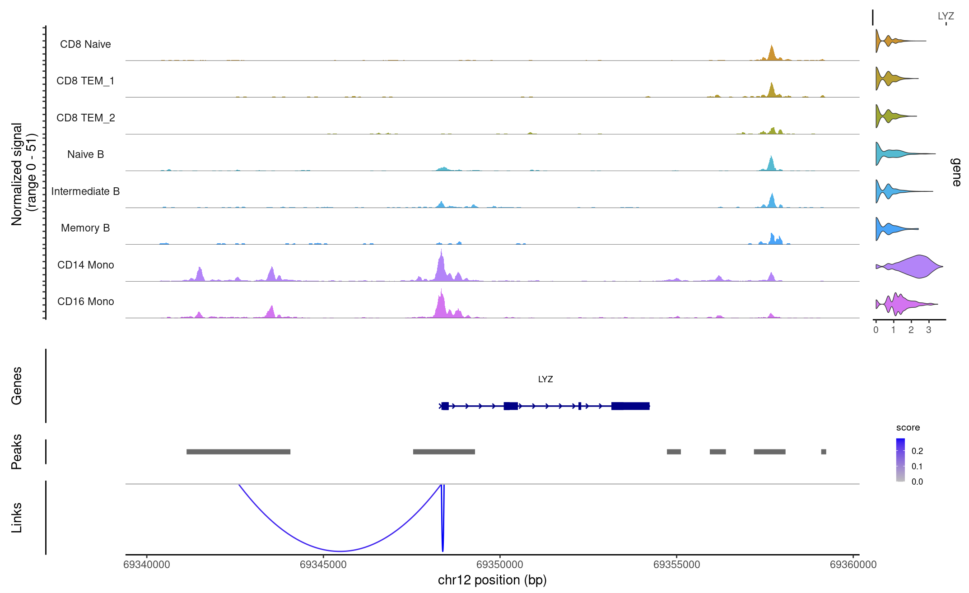
Peak-to-Gene Link Visualization
Averaged frequency of sequenced DNA fragments for different groups of cells within a given genomic region
Gene expression plot
Gene annotations within the given genomic region
Peak coordinates within the given genomic region
Peak-to-gene links

Slide 33
🍱 Lunch break: 12:00 – 13:30

Slide 34
Session 4: 13:30 – 14:20
Introduction to Matilda

Slide 35
Session 4: Introduction to Matilda
Brief introduction of Deep learning in general and in bioinformatics
Deep learning basics
Variational Auto-Encoder (VAE)
Introduction to Matilda

Slide 36
Session 4: Introduction to Matilda
🎯
Brief introduction of Deep learning in general and in bioinformatics
Deep learning basics
Variational Auto-Encoder (VAE)
Introduction to Matilda

Slide 37
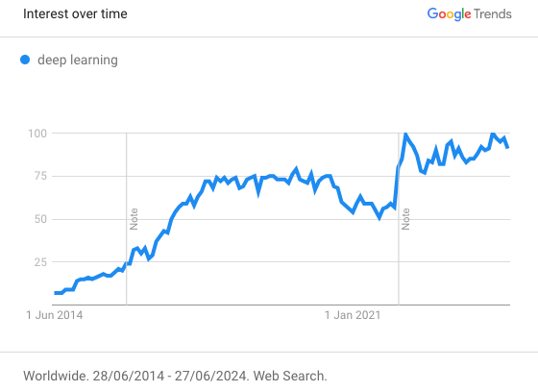
You Must Have Known about Deep Learning!
Trend of “Deep learning” in General Search over past 10 years

Slide 38









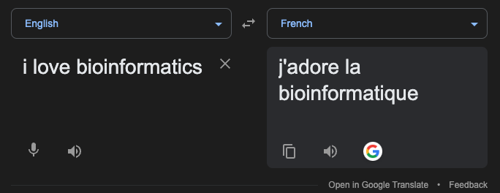

You Must Have Experienced Deep Learning!
Deep learning applications
Trend of “Deep learning” in General Search over past 10 years
Virtual Assistants
Chatbots
Healthcare
Recommendation
Advertising
Self-driving Cars
Machine Translation
Games
Fake News Detection
Fraud Detection
…
Hi Siri
YouTube
NETFLIX

Slide 39
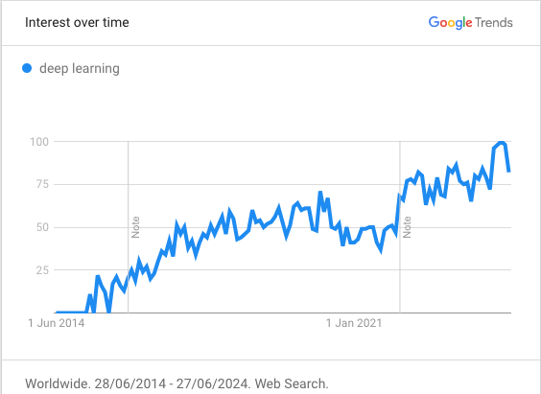
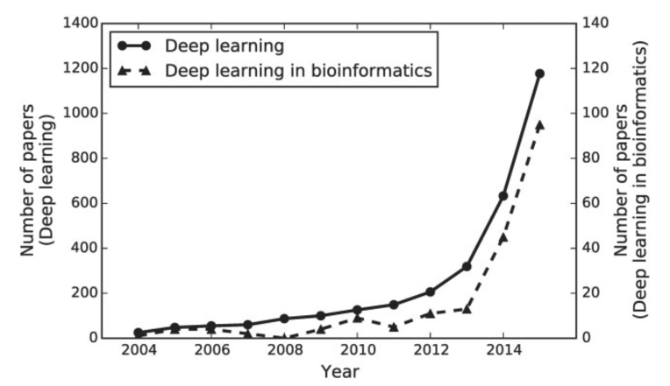
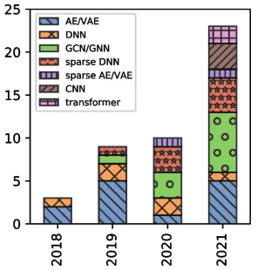
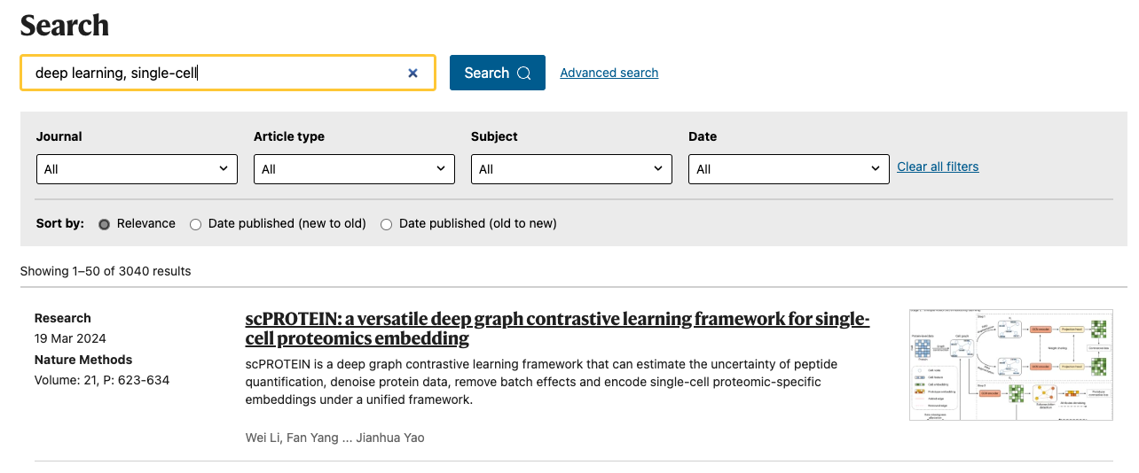
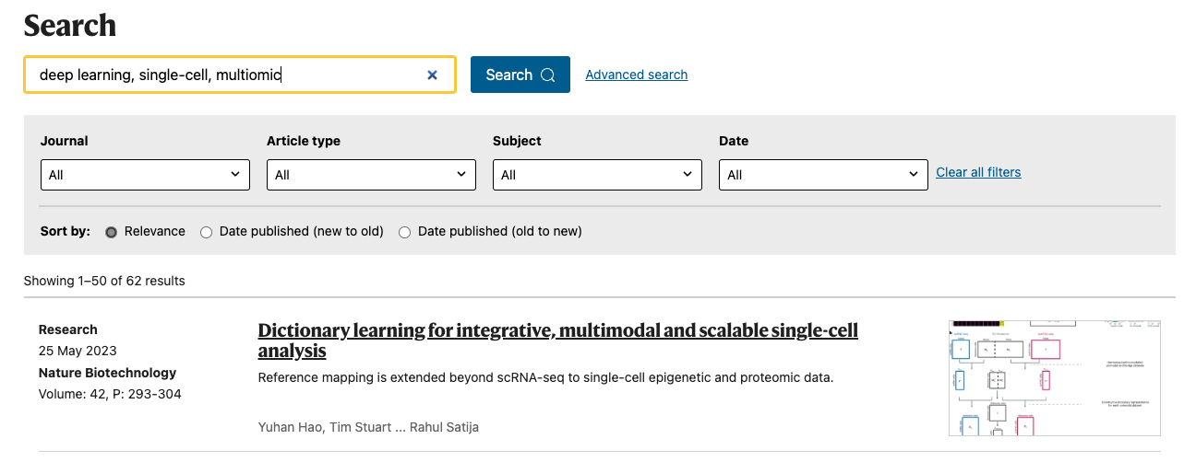
Deep learning in bioinformatics
Trend: increased applications of deep learning in bioinformatics and single-cell (multiomics) research
Trend of ”Deep learning” in Biological Science search over past 10 years
Approximate number of published deep learning articles by year
(Min et al, (2017), Briefings in bioinformatics)
Approximate number of specialized deep learning models in bioinformatics
(Wysocka et al, (2023), Nature Reviews Genetics)
Notes:
Why deep learning ?

Slide 40
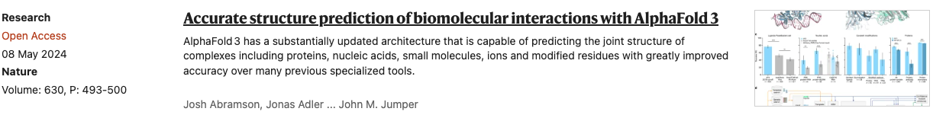
Deep learning in bioinformatics
Trend: increased applications of deep learning in bioinformatics and single-cell (multiomics) research
Protein structure prediction
Transformer-based
Approximate number of published deep learning articles by year
(Min et al, (2017), Briefings in bioinformatics)
Approximate number of specialized deep learning models in bioinformatics
(Wysocka et al, (2023), Nature Reviews Genetics)
Notes:
Why deep learning ?

Slide 41
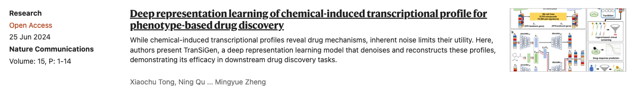
Deep learning in bioinformatics
Trend: increased applications of deep learning in bioinformatics and single-cell (multiomics) research
Protein structure prediction
Transformer-based
Drug discovery
VAE-based
Approximate number of published deep learning articles by year
(Min et al, (2017), Briefings in bioinformatics)
Approximate number of specialized deep learning models in bioinformatics
(Wysocka et al, (2023), Nature Reviews Genetics)
Notes:
Why deep learning ?

Slide 42
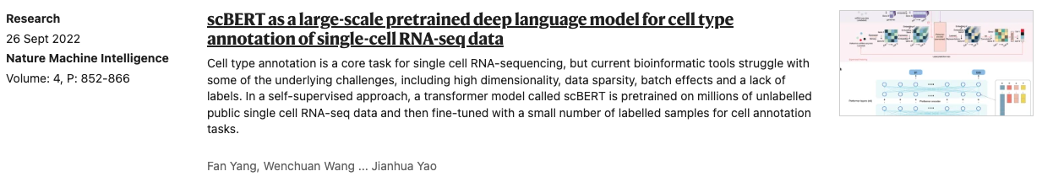
Deep learning in bioinformatics
Trend: increased applications of deep learning in bioinformatics and single-cell (multiomics) research
Protein structure prediction
Transformer-based
Drug discovery
VAE-based
Approximate number of published deep learning articles by year
(Min et al, (2017), Briefings in bioinformatics)
Approximate number of specialized deep learning models in bioinformatics
(Wysocka et al, (2023), Nature Reviews Genetics)
Cell type classification
Transformer-based
Notes:
Why deep learning ?

Slide 43
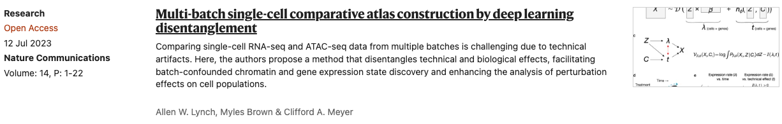
Deep learning in bioinformatics
Trend: increased applications of deep learning in bioinformatics and single-cell (multiomics) research
Protein structure prediction
Transformer-based
Drug discovery
VAE-based
Approximate number of published deep learning articles by year
(Min et al, (2017), Briefings in bioinformatics)
Approximate number of specialized deep learning models in bioinformatics
(Wysocka et al, (2023), Nature Reviews Genetics)
Cell type classification
Transformer-based
Single-cell atlas construction
VAE-based
Notes:
Why deep learning ?

Slide 44
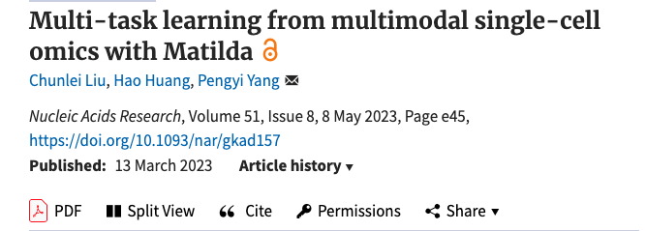
Deep learning in bioinformatics
Trend: increased applications of deep learning in bioinformatics and single-cell (multiomics) research
Protein structure prediction
Transformer-based
Drug discovery
VAE-based
Approximate number of published deep learning articles by year
(Min et al, (2017), Briefings in bioinformatics)
Approximate number of specialized deep learning models in bioinformatics
(Wysocka et al, (2023), Nature Reviews Genetics)
Cell type classification
Transformer-based
Single-cell atlas construction
VAE-based
Multiomic data integration
VAE-based
Notes:
Why deep learning ?

Slide 45
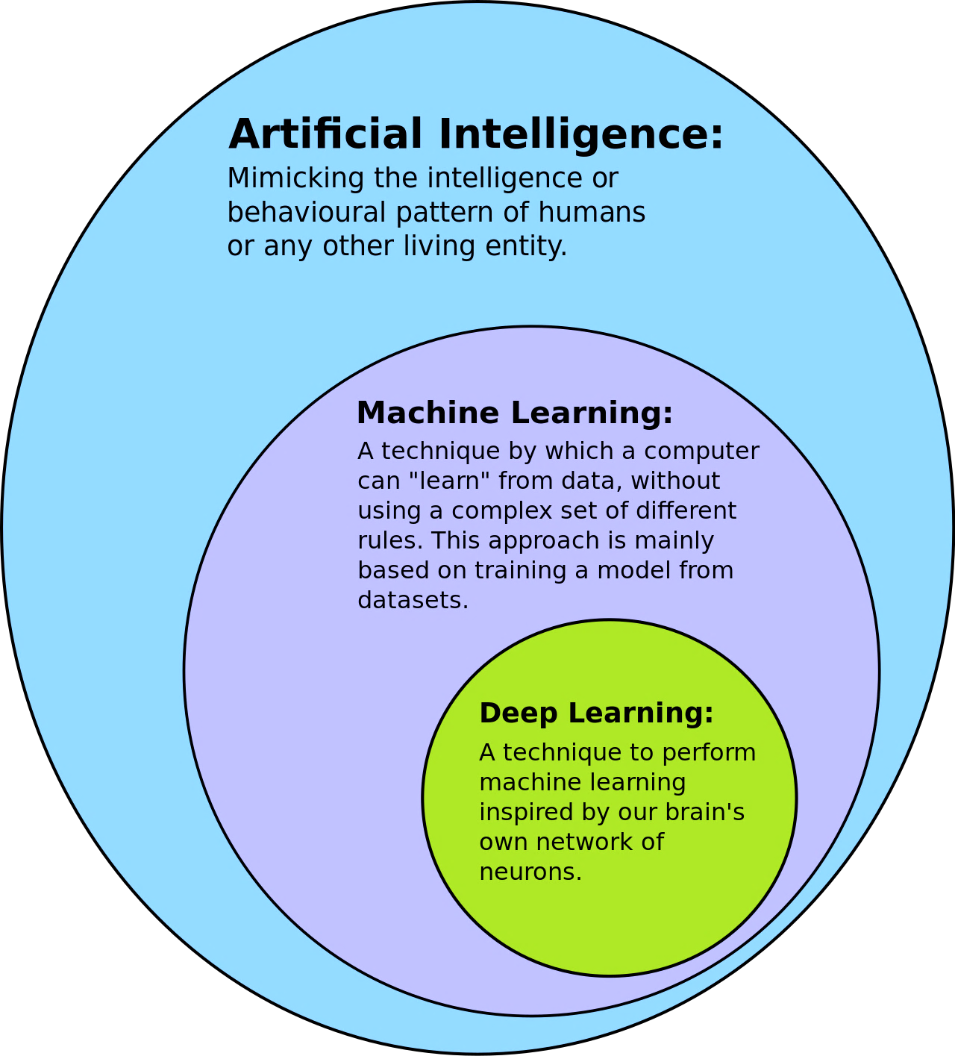
What is Deep learning?
Deep learning is:
a subset of machine learning that uses multilayered neural networks, called deep neural networks to simulate the complex decision-making power of the human brain.

Slide 46
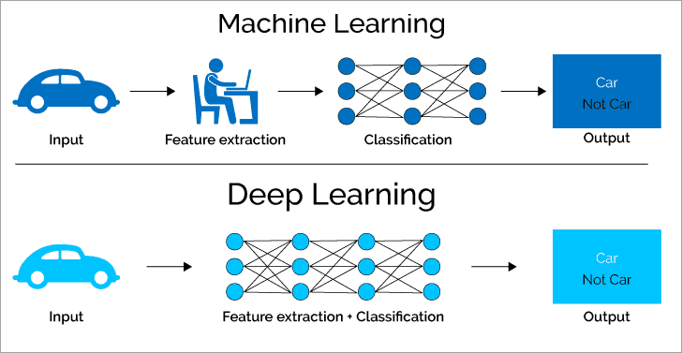
Advantages of Deep learning
General advantages:
End-to-end
Able to learn from highly complex features (by using back-propagation algorithm)
Able to learn from raw data in sheer volumes
Traditional machine learning VS. deep learning (softwaretestinghelp.com)

Slide 47
Advantages of Deep learning
General advantages:
End-to-end
Able to learn from highly complex features (by using back-propagation algorithm)
Able to learn from raw data in sheer volumes
Promising in bio research:
Handling high-dimensional complex bioinformatics data, e.g., genetic sequences, protein structures, cellular images.
Multimodal data integration, e.g., genomic, proteomic, phenotypic, providing a more holistic view of biological phenomena
New insights and novel discoveries using neural network approximation, e.g., identifying biomarkers for diseases, predicting the effects of genetic mutations.
Traditional machine learning VS. deep learning (softwaretestinghelp.com)

Slide 48
Session 4: Introduction to Matilda
Brief introduction of Deep learning in general and in bioinformatics
Deep learning basics
Variational Auto-Encoder (VAE)
Introduction to Matilda
🎯

Slide 49
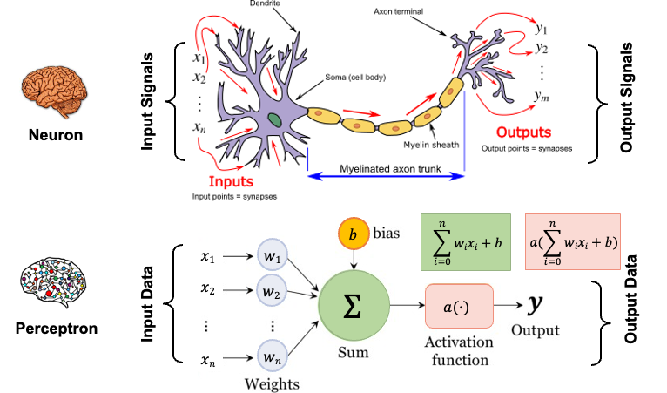
Modeling Neuron using Perceptron
Deep learning mimics the human brain’s ability to learn and process information.
Transfer function
Activation function

Slide 50
Modeling Neuron using Perceptron
Deep learning mimics the human brain’s ability to learn and process information.
Transfer function
Activation function
Weights (w) and bias (b) are parameters to be defined based our target goals.

Slide 51
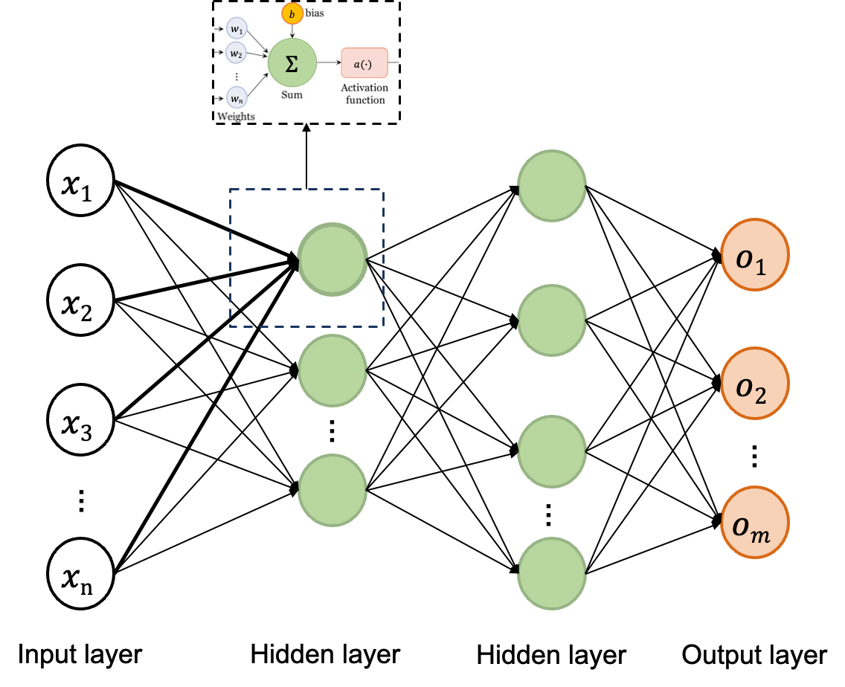
Typical Deep Neural Network
Deep learning learns in layers made of up interconnected neurons.

Slide 52
Typical Deep Neural Network
Deep learning learns in layers made of up interconnected neurons.
We will train the neural networks to find out the optimal weights w and bias b (i.e., parameters) for our target goals.

Slide 53
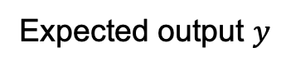
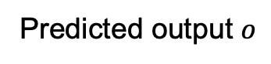
How to Train a Deep Neural Network
Neural network training is the process of find neural network parameters (e.g., weights) that minimize the error of the model output on the training dataset
Difference
i.e., error of model output
Weights
?
Biases
?
Training data
Neural Networks
Predicted output $o$
Expected output $y$
Forward pass

Slide 54
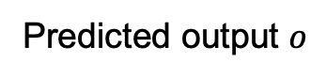
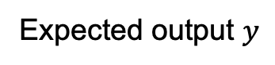
How to Train a Deep Neural Network
Neural network training is the process of find neural network parameters (e.g., weights) that minimize the error of the model output on the training dataset
Difference
i.e., error of model output
Weights
?
Biases
?
Training data
Neural Networks
Predicted output $o$
Expected output $y$
Example tasks
Cell type classification
Omics data
Predicted cell type
Ground truth cell type

Slide 55
How to Train a Deep Neural Network
Neural network training is the process of find neural network parameters (e.g., weights) that minimize the error of the model output on the training dataset
Difference
i.e., error of model output
Weights
?
Biases
?
Training data
Neural Networks
Predicted output $o$
Expected output $y$
Example tasks
Cell type classification
Omics data
Predicted cell type
Ground truth cell type
Data simulation
Simulated omics data
Real
omics data
Omics data

Slide 56
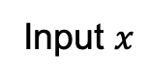
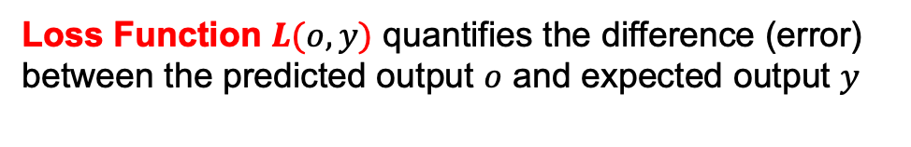

How to Train a Deep Neural Network
Loss Function $L$
Weights
?
Biases
?
Input $x$
Neural Networks
Predicted output $o$
Expected output $y$
Loss Function $L(o,y)$ quantifies the difference (error) between the predicted output $o$ and expected output $y$

Slide 57
How to Train a Deep Neural Network
Loss Function $L$
Weights
?
Biases
?
Input $x$
Neural Networks
Predicted output $o$
Expected output $y$
Task goal
Loss Function $L(o,y)$ quantifies the difference (error) between the predicted output $o$ and expected output $y$

Slide 58
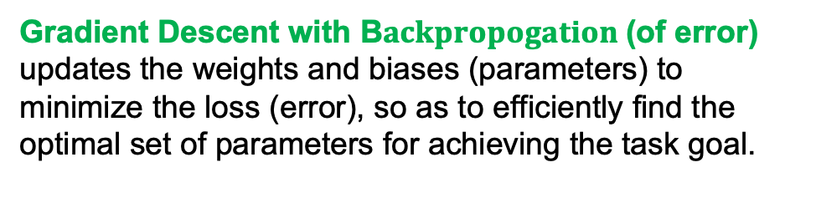
How to Train a Deep Neural Network
Update parameters
Loss Function $L$
Weights
?
Biases
?
Input $x$
Neural Networks
Predicted output $o$
Expected output $y$
Task goal
Loss Function $L(o,y)$ quantifies the difference (error) between the predicted output $o$ and expected output $y$
Gradient Descent with B$ackpropogation$(of error) updates the weights and biases (parameters) to minimize the loss (error), so as to efficiently find the optimal set of parameters for achieving the task goal.

Slide 59
How to Train a Deep Neural Network
Update parameters
Loss Function $L$
Weights
?
Biases
?
Input $x$
Neural Networks
Predicted output $o$
Expected output $y$
Task goal
Loss Function $L(o,y)$ quantifies the difference (error) between the predicted output $o$ and expected output $y$
Optimization
mechanism
Gradient Descent with B$ackpropogation$(of error) updates the weights and biases (parameters) to minimize the loss (error), so as to efficiently find the optimal set of parameters for achieving the task goal.

Slide 60




How to Train a Deep Neural Network
Gradient descent updates the parameters based on the gradients calculated by backpropagation (of error)
② Error is sent back to each neuron in backward direction
③ Gradient of error is calculated with respect to each parameter using chain rule
① Error - difference between predicted and expected output
Loss Function $L$ (error)
Weights
?
Biases
?
Input $x$
Neural Networks
Predicted output $o$
Expected output $y$
Backpropagation (of error)

Slide 61






How to Train a Deep Neural Network
Gradient descent via backpropagation
Gradient descent is an iterative algorithm, that starts from a random point on a function and travels down its slope in steps until it reaches the lowest point of that function
Initial weight $wold$
1. With initial parameters ($wold$), forward pass to calculate the loss (error)
2. Backpropagate to calculate the gradient for each parameter
3. Update the parameters according to the negative gradient -> moving downward to the minimum point of the loss function
Loss
Learning rate $α$
New weight $wnew$
gradient
Update rule:
$$wnew=wold − α \frac{∂L}{∂w}$$
Learning rate
Weight
A tunning parameter that determines the step size at each iteration
Minimum point
of loss function
4. Repeat step 1-3 until the training process is finished

Slide 62
How to Train a Deep Neural Network
Three primary types of gradient descent used for training the neural network
These strategies differ in how much data we use to update the weights for one iteration
Batch Gradient Descent | Stochastic Gradient Descent (SGD) | Mini-batch Gradient Descent
Use all training samples in one iteration for parameter update | Use one training sample in one iteration for parameter update | Use a batch of training samples in one iteration for parameter update

Slide 63
How to Train a Deep Neural Network
Three primary types of gradient descent used for training the neural network
These strategies differ in how much data we use to update the weights for one iteration
Batch Gradient Descent | Stochastic Gradient Descent (SGD) | Mini-batch Gradient Descent
Use all training samples in one iteration for parameter update | Use one training sample in one iteration for parameter update | Use a batch of training samples in one iteration for parameter update
When iterating over the entire dataset through Gradient Descent, we call it one Epoch
The number of data in one batch for mini-batch gradient descent is defined by Batch size

Slide 64


Deep Neural Network – training and inference
Two main procedures in deep learning.
Forward pass
Calculate Loss
Backpropagation
Constructed
neural network
Training
Training data
Predicted output $o$
Expected output $y$
Forward pass
Trained
neural network
Inference
New data
(unseen during training)
Predicted output $o$

Slide 65

Deep Neural Network – training and inference
Two main procedures in deep learning.
Forward pass
Calculate Loss
Backpropagation
Constructed
neural network
Training
Training data
Predicted output $o$
Expected output $y$
When expected output is available
Forward pass
Evaluate performance
Trained
neural network
Inference
Test data
(unseen during training)
Predicted output $o$
Expected output $y$

Slide 66
Session 4: Introduction to Matilda
Brief introduction of Deep learning in general and in bioinformatics
Deep learning basics
Variational Auto-Encoder (VAE)
Introduction to Matilda
🎯

Slide 67

Auto-Encoder (AE)
A simple generative model, which is primarily used for the task of unsupervised feature learning, dimension reduction, and data simulation etc.
Essentially neural network (NN) architectures trained based on a reconstruction loss.

Slide 68


Auto-Encoder (AE)
Encoder e:
Learns to compress the input data x to a lower-dimensional latent space Z
Decoder d:
Learns to reconstruct the original input from the learned latent space Z
Reconstruction Loss L:
$L(x,d\left(z\right))={||x−d\left(z\right)||}^{2}$

Slide 69


Auto-Encoder (AE)
Generating data (decoding) based on learned latent space
Training process
Generation process

Slide 70
Problems of Auto-Encoder (AE)
Generating data (decoding) based on learned latent space
Problems of VAE:
The only training objective is reconstruction
Latent space learned lacks regularization
Generated data can be meaningless
Training process
Generation process

Slide 71
Problems of Auto-Encoder (AE)
Generating data (decoding) based on learned latent space
Problems of VAE:
The only training objective is reconstruction
Latent space learned lacks regularization
Generated data can be meaningless
Training process
Solution from
Variational Auto-Encoder (VAE):
Regulate the latent space!!!
Generation process

Slide 72

Main difference between AE and VAE

Slide 73

Variational Auto-Encoder (VAE)
VAE encoding-decoding process:
Encode the input as distributions over the latent space
Sample a latent vector from the distributions
Decode the latent vector as reconstructed data

Slide 74

Variational Auto-Encoder (VAE)
VAE encoding-decoding process:
Encode the input as distributions over the latent space
Sample a latent vector from the distributions
Decode the latent vector as reconstructed data
VAE loss function:
$$L={||x−d\left(z\right)||}^{2}+KL[N\left(μx ,σx\right),N(0,I)]$$
Reconstruction loss
Regularization term

Slide 75
Session 4: Introduction to Matilda
Brief introduction of Deep learning in general and in bioinformatics
Deep learning basics
Variational Auto-Encoder (VAE)
Introduction to Matilda
🎯

Slide 76

Recent advancement in single-cell multimodal omics
TEA-seq
The recent advancements in Single-cell multimodal omics technologies enable multiple molecular programs to be simultaneously profiled at a global scale in individual cells.

Slide 77
Challenges on integrative analysis of mlutiomic data
TEA-seq
Challenge:
The lack of computational methods that can integrate across data modalities is a key issue in single-cell multimodal omics data analysis and greatly hinder biological discovery from such data

Slide 78

Multiomic Count Matrix Data Format
CITE-seq
cell 1
cell n
cell 2
……
feature 1
feature 2
TEA-seq
……
ADT
SHARE-seq
feature m
(Or 10x multiome in our tutorial code)
cell 1
cell n
cell 2
……
feature 1
feature 2
……
ATAC
feature n
(Gene Activity Score)

Slide 79
Motivations and Goals of Matilda
Matilda is proposed to address the challenge of multimodal omics data analysis
A key observation in Matilda is that many common tasks in single-cell multimodal omics data analysis are closely related
By exploiting the interrelationship among tasks, Matilda learns to perform data simulation, cell type classification, dimension reduction, and feature selection in a single unified framework, i.e., multi-task learning

Slide 80

Framework Overview
Multi-task learning in a unified framework
Task ④
VAE
Task ①
Task ②
Task ③

Slide 81
Framework Overview
Two main branches for network learning (training)
VAE
Simulation branch
Classification branch

Slide 82










Network training / learning
Simulation branch
Data reconstruction
Multimodal input
Modality-specific encoders
Joint learning encoder
Joint latent space
Modality-specific decoders
$$xrna$$
$$mrna=erna(xrna)$$
$$μ,σ=ejoint(mrna⨁matac)$$
$$z=ζσ+μ$$
$$x′rna=drna(z)$$
$$xatac$$
$$matac=eatac(xatac)$$
$$ζ\sim N(0,I)$$
$$x^{′}atac=datac(z)$$
VAE loss
Simulation loss:
Reconstruction loss
Regularization term

Slide 83












Network training / learning
Cell type classifier
(NN)
Classification branch
$$Youtput$$
(Predicted cell type)
Cell type classification
Multimodal input
Modality-specific encoders
Joint learning encoder
Joint latent space
Cell type classifier
$$xrna$$
$$mrna=erna(xrna)$$
$$μ,σ=ejoint(mrna⨁matac)$$
$$z=ζσ+μ$$
$$Youtput=NNcls(z)$$
$$xatac$$
$$matac=eatac(xatac)$$
$$ζ\sim N(0,I)$$
Classification loss:

Slide 84


Network training / learning
Simulation branch
Classification branch
Simulation loss:
Classification loss:
Integrated loss:

Slide 85
Model training - Augmentation and Balance Strategy
Common problem encountered in real-world dataset : Imbalanced data
Minor cell type
<
Median cell type
<
Major cell type
Data augmentation
Data downsample
Anchor
cell type
Minor
cell type
Augmented data
Anchor
cell type
Downsampled data
Major
cell type

Slide 86

Multi-tasking
Reconstructed (decoded) data for data simulation
Multimodal data (specific cell type)
Trained Matilda
Reconstructed Multimodal data (specific cell type)

Slide 87
Multi-tasking
Cell type classification
Multimodal data
Trained Matilda
Predicted cell type

Slide 88
Multi-tasking
Data integration and dimension reduction
Multimodal data
Trained Matilda
Dimension reduced joint embedding

Slide 89
Multi-tasking
Feature selection
Multimodal data (different cell type)
Trained Matilda
Important features for defining each cell type

Slide 90




Multi-tasking
Feature selection
Integrated Gradient (IG) for feature selection
Gradient of classification function $F\left(∙\right)$along the $ith$ dimension
Multimodal data (different cell type)
Trained Matilda
Important features for defining each cell type
Importance score of feature $j$
Gradients along the $jth$ dimension are accumulated alone a path that observes the change from the baseline $X$’ (all zeros) to input $X$
Recall: gradients are calculated via backpropagation

Slide 91


Matilda available as Python package – We will try soon!
Matilda Python package and website: https://liuchunlei0430/Matilda/

Slide 92
Short break: 14:20 – 14:30

Slide 93
Session 5: 14:30 – 15:30
Multi-modal analysis of 10x multiome data with Matilda

Slide 94
Session 5: Multi-modal analysis of 10x multiome data with Matilda
Recap of the 4 tasks
2. Introduction to datasets and Matilda pipeline
3. Code Practice 1 (Data preparation + Matilda Running)
4. Introduction to Matilda visualization and analysis
5. Code Practice 2 (Matilda visualization and analysis)

Slide 95
Session 5: Multi-modal analysis of 10x multiome data with Matilda
🎯
Recap of the 4 tasks
2. Introduction to datasets and Matilda pipeline
3. Code Practice 1 (Data preparation + Matilda Running)
4. Introduction to Matilda visualization and analysis
5. Code Practice 2 (Matilda visualization and analysis)

Slide 96
Recap: Multi-tasks of Matilda
Data integration and dimension reduction
Feature selection
Multimodal data
Trained Matilda
Dimension reduced joint embedding
Multimodal data (different cell type)
Trained Matilda
Important features for defining each cell type
Reconstructed (decoded) data for data simulation
Cell type classification
Multimodal data (specific cell type)
Trained Matilda
Reconstructed Multimodal data (specific cell type)
Multimodal data
Trained Matilda
Predicted cell type

Slide 97
Session 5: Multi-modal analysis of 10x multiome data with Matilda
Recap of the 4 tasks
2. Introduction to datasets and Matilda pipeline
3. Code Practice 1 (Data preparation + Matilda Running)
4. Introduction to Matilda visualization and analysis
5. Code Practice 2 (Matilda visualization and analysis)
🎯

Slide 98

10x Multiome Dataset – Basic Information
pbmc query
(10x Multiome)
2714 cells
36601 genes
156607 regions
pbmc reference
(10x Multiome)
10412 cells
36601 genes
106050 regions
19 cell types

Slide 99
10x Multiome Dataset – Basic Information
pbmc query
(10x Multiome)
2714 cells
36601 genes
156607 regions
pbmc reference
(10x Multiome)
10412 cells
36601 genes
106050 regions
19 cell types
100%
20%
80%
Test set
(Not annotated)
Training set
(Annotated)
Evaluation set
(Annotated)

Slide 100
10x Multiome Dataset – Basic Information
Training set
(Annotated)
Matilda
Training
Evaluation set
(Annotated)
Trained
Matilda
Inference
Test set
(Not annotated)

Slide 101
10x Multiome Dataset – Basic Information
Training set
(Annotated)
Matilda
Training
Data simulation
Cell type classification
Evaluation set
(Annotated)
Data integration and dimension reduction
Trained
Matilda
Inference
Test set
(Not annotated)
Feature selection

Slide 102
10x Multiome Dataset – Basic Information
Training set
(Annotated)
Matilda
Training
Data simulation
Training set
Cell type classification
Evaluation set
Test set
Evaluation set
(Annotated)
Data integration and dimension reduction
Trained
Matilda
Inference
Evaluation set
Test set
Test set
(Not annotated)
Feature selection
Evaluation set

Slide 103

Integrative Analysis with Matilda - Pipeline
Train + Eval + Test

Slide 104
Session 5: Multi-modal analysis of 10x multiome data with Matilda
Recap of the 4 tasks
2. Introduction to datasets and Matilda pipeline
3. Code Practice 1 (Data preparation + Matilda Running)
4. Introduction to Matilda visualization and analysis
5. Code Practice 2 (Matilda visualization and analysis)
🎯

Slide 105
Integrative Analysis with Matilda – Code Practice
Step 1
Step 2
Train + Eval + Test

Slide 106
Session 5: Multi-modal analysis of 10x multiome data with Matilda
Recap of the 4 tasks
2. Introduction to datasets and Matilda pipeline
3. Code Practice 1 (Data preparation + Matilda Running)
4. Introduction to Matilda visualization and analysis
5. Code Practice 2 (Matilda visualization and analysis)
🎯

Slide 107





Analysis - Task ① - Data Simulation – 10x Multiome
Heatmap visualization of the correlation structure of real and Matilda simulated data.
SHARE-seq RNA modality
SHARE-seq ATAC modality
Real data
Matilda-simulated
Real data
Matilda-simulated
Top-100 HVGs by RNA
Top-100 HVGs by ATAC

Slide 108
Analysis - Task ① - Data Simulation – 10x Multiome
Heatmap visualization of the correlation structure of real and Matilda simulated data.
SHARE-seq RNA modality
SHARE-seq ATAC modality
Real data
Matilda-simulated
Real data
Matilda-simulated
Top-100 HVGs by RNA
Top-100 HVGs by ATAC
Similar gene-gene correlation patterns can be observed between the real and Matilda-simulated data.

Slide 109










Analysis - Task ① - Data Simulation – 10x Multiome
UMAP visualization of cell-type-specific simulations.
CD16 Mono
CD8 Naive
Real
Real
Real
Real
Other cell type
Anchor cell type
Matilda-simulated
Matilda-simulated
Matilda-simulated
Matilda-simulated

Slide 110
Analysis - Task ① - Data Simulation – 10x Multiome
UMAP visualization of cell-type-specific simulations.
CD16 Mono
CD8 Naive
Real
Real
Real
Real
Other cell type
Anchor cell type
Matilda-simulated
Matilda-simulated
Matilda-simulated
Matilda-simulated
Real and simulated data are similar in UMAP.

Slide 111

Analysis - Task ② - Classification – 10x Multiome
Classification accuracy for each type

Slide 112
Analysis - Task ② - Classification – 10x Multiome
Classification accuracy for each type
Comparatively, Memory B and gdT got low accuracy (53.96% and 37.39%)

Slide 113

Analysis - Task ② - Classification – 10x Multiome
Confusion matrix of classification result for each type (10x multiome example from our tutorial code)

Slide 114
Analysis - Task ② - Classification – 10x Multiome
Confusion matrix of classification result for each type (10x multiome example from our tutorial code)
Plasma
Native B
Memory B
Intermediate B
cDC
CD4 TCM
CD16 Mono
Detailed classification results of Memory B

Slide 115
Analysis - Task ② - Classification – 10x Multiome
Confusion matrix of classification result for each type (10x multiome example from our tutorial code)
NK
MAIT
gdT
CD8 TEM_2
CD8 TEM_1
CD8 Naive
Detailed classification results of gdT

Slide 116

Analysis - Task ③ - Data Integration & Dimension Reduction
Clustering visualization of joint multimodal dimension reduction results for 10x Multiome.
Cells are separated well based on cell type.

Slide 117

Analysis - Task ④ - Feature Selection – 10x Multiome
UMAPs highlight representative markers selected from each of the two modalities for CD16 Mono cells.
The Matilda-selected representative genes may indicate potential markers for defining the cell type.

Slide 118
Session 5: Multi-modal analysis of 10x multiome data with Matilda
Recap of the 4 tasks
2. Introduction to datasets and Matilda pipeline
3. Code Practice 1 (Data preparation + Matilda Running)
4. Introduction to Matilda visualization and analysis
5. Code Practice 2 (Matilda visualization and analysis)
🎯

Slide 119
Integrative Analysis with Matilda – Code Practice
Step 3

Slide 120
Session 7: 15:30 – 16:00
Conclusion and wrap up

Slide 121





Acknowledgments
Computational Systems Biology
Unit:
Pengyi Yang
Carissa Chen
Di Xiao
Katie Zyner
Eren Ekmen
Anna Fredericks
Chunlei Liu
Daniel Kim
Lijia Yu
Sichang Ding
Manoj M. Wagle
Sydney Precision Data Science Centre:
Jean Yang
Garth Tarr
Samuel Mueller
Ellis Patrick
Rachel Wang
John Ormerod
Shila Ghazanfar
Dario Strbenac
Nick Robertson
Yue Cao
Helen Fu
Beilei Bian
Andy Tran
Wenze Ding
Chuhan Wang
Fei Yang
Farhan Ameen
Harry Robertson
Jackson Zhou
Swarbrick Lab:
Hani Kim
Zhao Lab:
Yingxin Lin

Slide 122
References
https://en.wikipedia.org/wiki/CITE-Seq
Ma, S., Zhang, B., LaFave, L.M., Earl, A.S., Chiang, Z., Hu, Y., Ding, J., Brack, A., Kartha, V.K., Tay, T. and Law, T., 2020. Chromatin potential identified by shared single-cell profiling of RNA and chromatin. Cell, 183(4), pp.1103-1116.
Swanson, E., Lord, C., Reading, J., Heubeck, A.T., Genge, P.C., Thomson, Z., Weiss, M.D., Li, X.J., Savage, A.K., Green, R.R. and Torgerson, T.R., 2021. Simultaneous trimodal single-cell measurement of transcripts, epitopes, and chromatin accessibility using TEA-seq. Elife, 10, p.e63632.
Wagle, M.M., Long, S., Chen, C., Liu, C. and Yang, P., 2024. Interpretable deep learning in single-cell omics. Bioinformatics, p.btae374.
Heumos, L., Schaar, A.C., Lance, C., Litinetskaya, A., Drost, F., Zappia, L., Lücken, M.D., Strobl, D.C., Henao, J. and Curion, F., 2023. Best practices for single-cell analysis across modalities. Nature Reviews Genetics, 24(8), pp.550-572.
https://levity.ai/blog/difference-machine-learning-deep-learning
https://en.wikipedia.org/wiki/Deep_learning
https://en.wikipedia.org/wiki/Biological_neuron_model
Min, S., Lee, B. and Yoon, S., 2017. Deep learning in bioinformatics. Briefings in bioinformatics, 18(5), pp.851-869.

